Slide 1
FORMS OF OWNERSHIP
Sole Proprietorship
Partnership
Company

Slide 2
 | Sole Proprietorship | Partnership | Company
Definition | A business which is owned and controlled by one person. | A relation between the persons who have agreed to share the profit or loss of the business carried by all or any one of them acting for all. | Company is an artificial person created by law.
Legal Entity | No separate entity from its owners | No separate entity from its owners | Has a separate legal entity from its members
Law | There is no specific law for the formation of sole proprietorship | Formed under Partnership Act 1932 | Formed under Companies Ordinance 1984
Registration | Registration is not compulsory | Registration of partnership is optional | Registration of company is compulsory by law
Number of Partners | There is only one owner | Minimum 2 and maximum 20 partners | Minimum seven and maximum unlimited

Slide 3
 | Sole Proprietorship | Partnership | Company
Management | Managed by single owner | Every partner has a right to participate in management | Company is managed by a board of directors
Liability | Liability of owner is unlimited | Liability of each member is unlimited | Liability of members is limited
Durability | Not durable | More durable as compare to sole proprietorship but less as compared to company | Death or insolvency of member has no effect on life of company
Suitable for | Suitable for small scale business | Suitable for small and medium size business | Suitable for large scale business

Slide 4
 | Sole Proprietorship | Partnership | Company
Transfer of Shares/business | Sole trader can sell his business without any restriction | In partnership no partner can transfer his share without the consent of other partners | In public limited company shares can be transferred without any restriction
Change in Capital | Sole trader can change volume of capital when he wants | In partnership partners can change volume of capital with mutual consent | In Company volume of capital can be changed according to rules given in ordinance
Payment of Debt | In sole proprietorship private property of owner can also be used to pay debt | Private property of partners can be used to pay debt | Private property of shareholders can not be used to pay debt
Change in Business | Sole trader can change his business at any time | Business can be changed with mutual consent of partners | Company can do only those businesses which are mentioned in MOA
Stock Exchange | Can not be listed in stock exchange | Cannot be listed in stock exchange | Public limited company can register itself in stock exchange

Slide 5
 | Sole Proprietorship | Partnership | Company
Expense of incorporation | bears less formation expenses as compared to other businesses | bears less formation expenses as compared to company | Formation expenses of company are much more as compared to other businesses
Withdrawal of Capital | Sole owner can get his capital by selling his business to other | Partners can get their capital by transferring their share to others by mutual consent | Shareholders can get their capital by selling share to others without any restriction
Winding Up | can be wind up without out any restriction | can be dissolved according to partnership agreement | can be wind up according rules of ordinance

Slide 6
SHARES
The capital of a company is divided into small unit and each unit is called a share.

Slide 7
ORGANIZATIONAL CHART

Slide 8
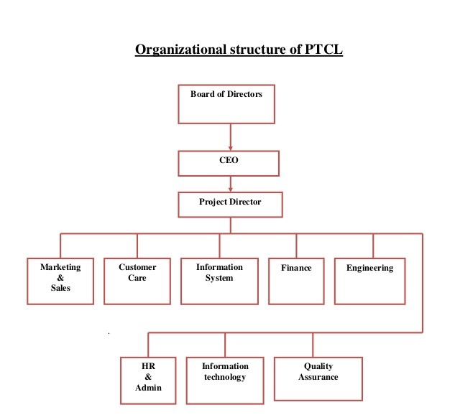

Slide 9
DEVELOPING THE MANAGEMENT TEAM
The management team should not only be competent but also committed. The investors demand that management team operates the business as a full time venture.

Slide 10
BOARD OF DIRECTORS
The board of directors may serve a number of functions:
(1) reviewing operating and capital budgets,
(2) developing longer-term strategic plans for growth and expansion,
(3) supporting day-to-day activities,
(4) resolving conflicts among owners or shareholders,
(5) ensuring the proper use of assets, or
(6) developing a network of information sources for the entrepreneurs.

Slide 11
Functions of Management
Planning
Organizing
Commanding
Coordinating
Controlling

Slide 12
Useful Links
www.secp.gov.pk
www.jamapunji.pk

Slide 14
Organizational Goals
Purposes of goals:
They provide guidance and a unified direction for people in the organization. Goals can help everyone understand where the organization is going and why getting there is important.
Effective goal setting promotes good planning, and good planning facilitates future goal setting.
Goals can serve as a source of motivation for employees of the organization.
Goals provide an effective mechanism for evaluation and control. This means that performance can be assessed in the future in terms of how successfully today’s goals are accomplished.

Slide 15
Kinds of goals
Strategic goals are goals set by and for top management of the organization. They focus on broad, general issues.
For example, Starbucks has a strategic goal of increasing the profitability of each of its coffee stores by 25 percent over the next five years.

Slide 16
Tactical goals
Tactical goals are set by and for middle managers.
Their focus is on how to operationalize actions necessary to achieve the strategic goals.
To achieve Starbucks’ goal of increasing its per‑store profitability, managers are working on tactical goals related to company‑owned versus licensed stores and the global distribution of stores in different countries.

Slide 17
Operational goals
Operational goals are set by and for lower‑level managers.
Their concern is with shorter term issues associated with the tactical goals. An operational goal for Starbucks might be to boost the profitability of a certain number of stores in each of the next five years.

Slide 18
Time frame

Slide 19
Kinds of Organizational plans
Strategic Plans:
Strategic plans are the plans developed to achieve strategic goals. More precisely, a strategic plan is a general plan outlining decisions of resource allocation, priorities, and action steps necessary to reach strategic goals. These plans are set by the board of directors and top management, generally have an extended time horizon, and address questions of scope, resource deployment, competitive advantage.

Slide 20
Tactical Plans
A tactical plan, aimed at achieving tactical goals, is developed to implement specific parts of a strategic plan.
Tactical plans typically involve upper and middle management and, compared with strategic plans, have a somewhat shorter time horizon and a more specific and concrete focus.

Slide 21
Operational Plans
An operational plan focuses on carrying out tactical plans to achieve operational goals. Developed by middle and lower‑level managers, operational plans have a short‑term focus and are relatively narrow in scope.

Slide 22
Time Frames for Planning
Long-Range Plans
A long-range plan covers many years, perhaps even decades.
Intermediate Plans
Intermediate plans usually cover periods from one to five years and are especially important for middle and first‑line managers.
Short-Range
Plans Managers also develop short-range plans, which have a time frame of one year or less.

Slide 23
Responsibilities for Planning
Planning Staff
Planning Task Force
Board of Directors
Chief Executive Officer
Executive Committee
Line Management

Slide 24
Contingency planning and Crisis Management
Contingency Planning:
The determination of alternative courses of action to be taken if an intended plan of action is unexpectedly disrupted or rendered inappropriate.
Crisis Management:
A related concept, is the set of procedures the organization uses in the event of a disaster or other unexpected calamity.

